Slide 1



Systems Thinking in Water Neutrality: Insights from Our Participatory Approach
VENTURA Case Study Summary
April 2024
Koko Zhou
Email: Ke.zhou@ucl.ac.uk
University College London

Slide 2
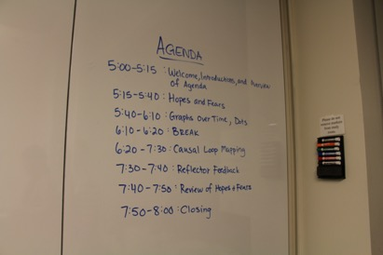
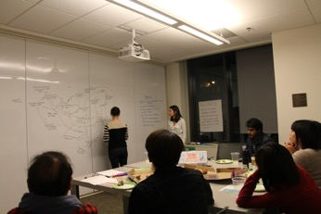

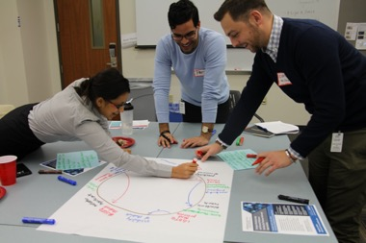
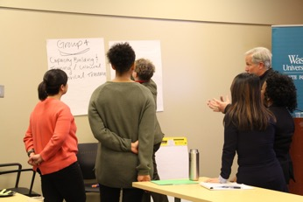
Participatory approaches in systems thinking
Problem definition
System conceptualization
Model development
Validation and analysis
Insights and ownership transference
Iterative process
Group model building workshop examples

Slide 3
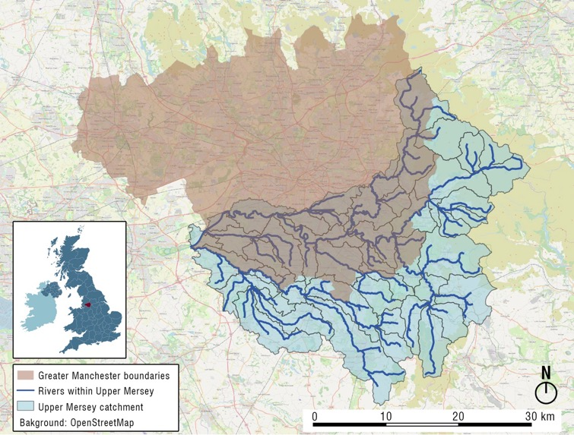
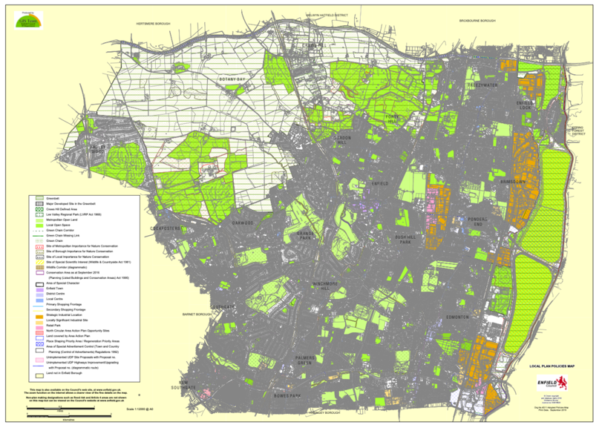
Two case studies in VENTURA
Sustainable development and organizational perceptions
Governance
Manchester, UK
Enfield, London, UK
The VENTURA research team, through two case studies, aims to understand the local challenges of water neutrality faced by stakeholders and to co-create digital solutions.

Slide 4
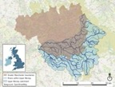
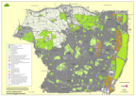
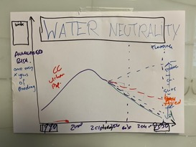
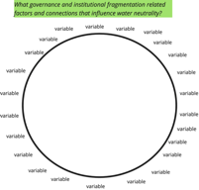
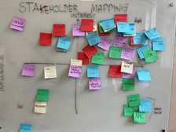
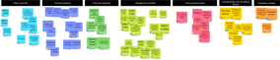
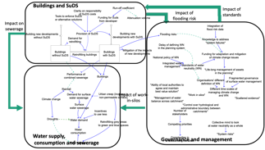
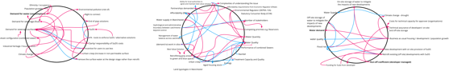
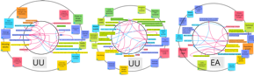
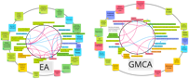
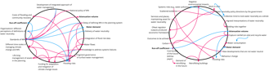
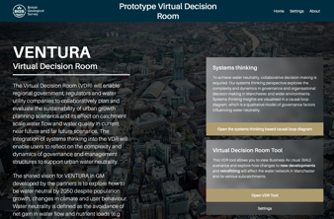
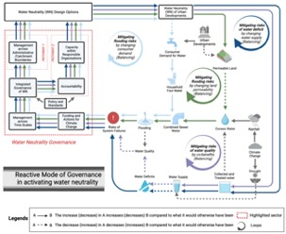
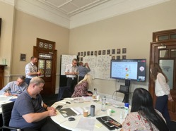
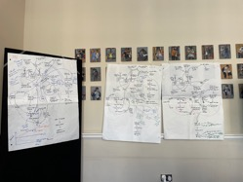
Engagement in Manchester
Stakeholders’ input
Research process
Researchers’ input
A. Problem framing
(‘design workshop’)
2
1
3
B. Individual interviews
(‘connection circles’)
4
6
5
C. Group workshops
(‘group-model-building workshops’)

Slide 5
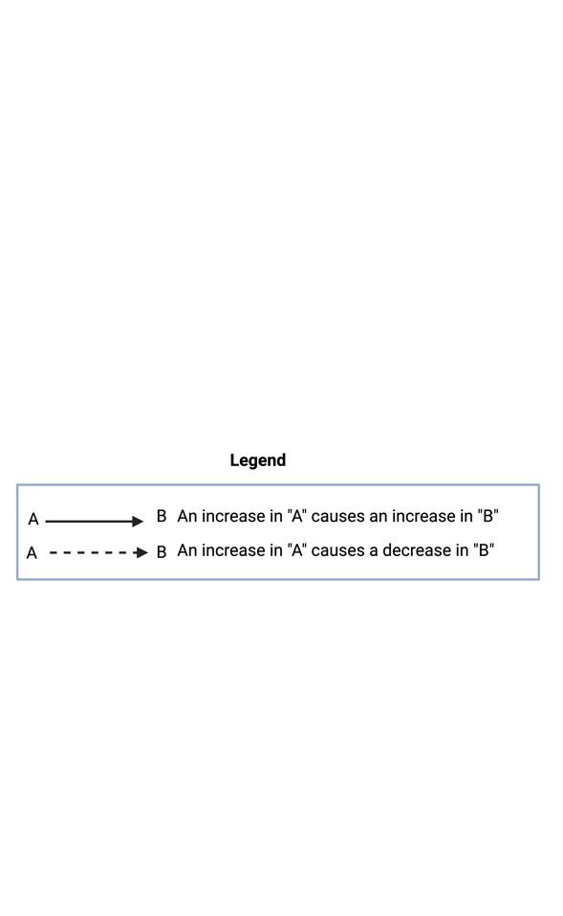
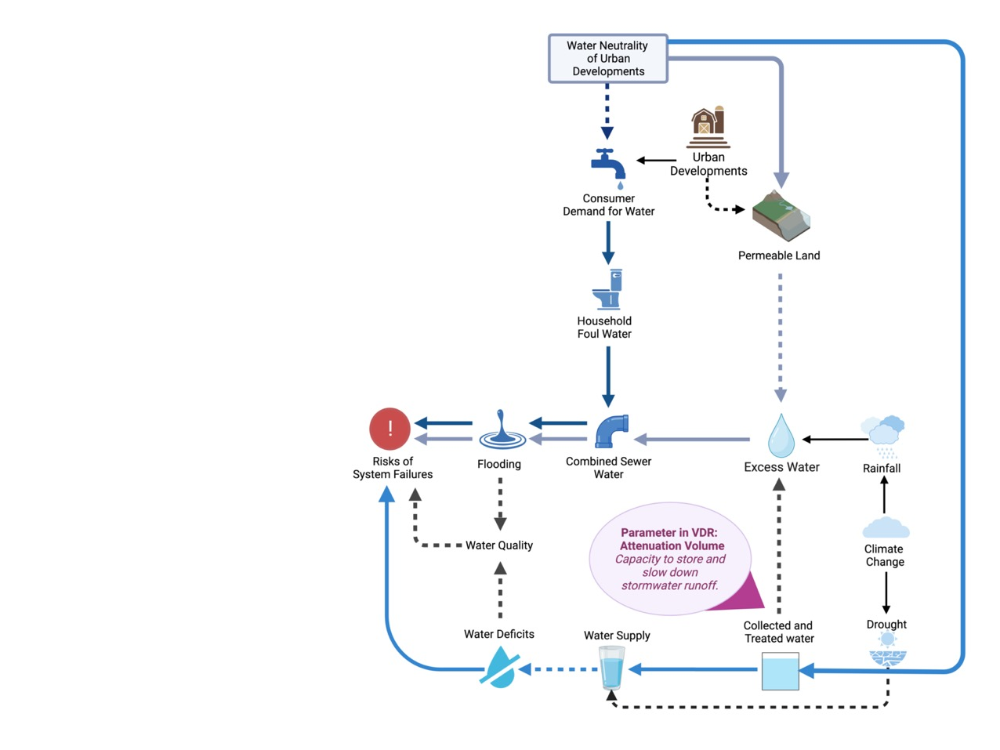
Manchester case study causal loop diagram (1)

Slide 6
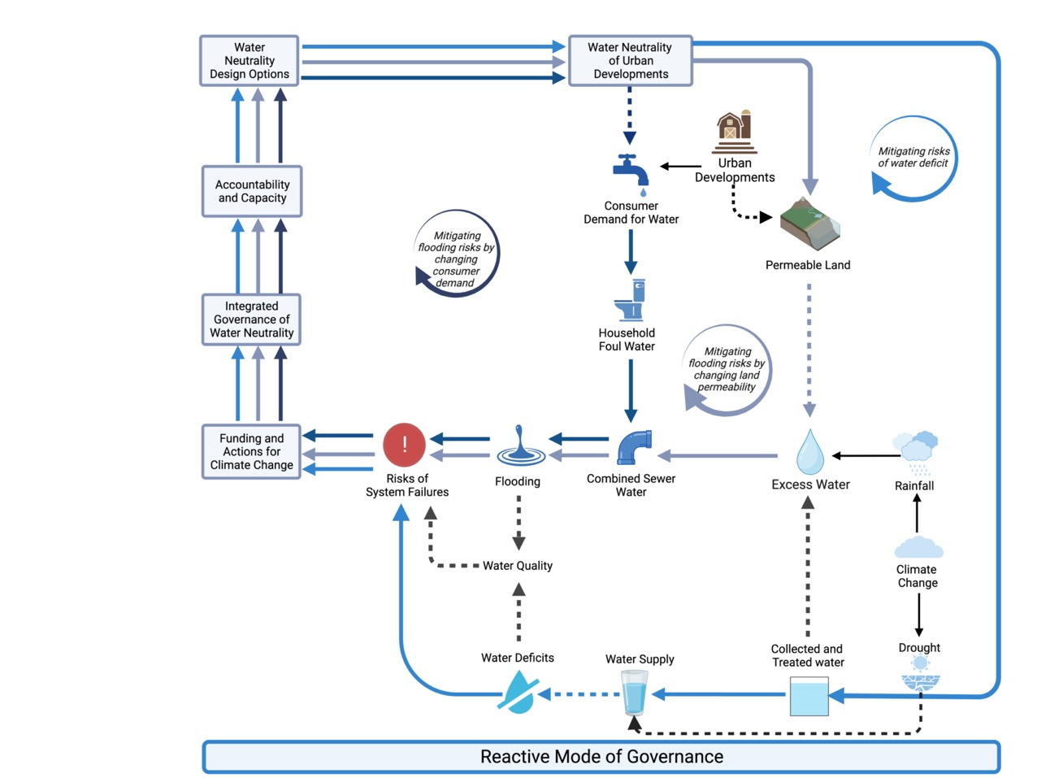
Manchester case study causal loop diagram (2)

Slide 7
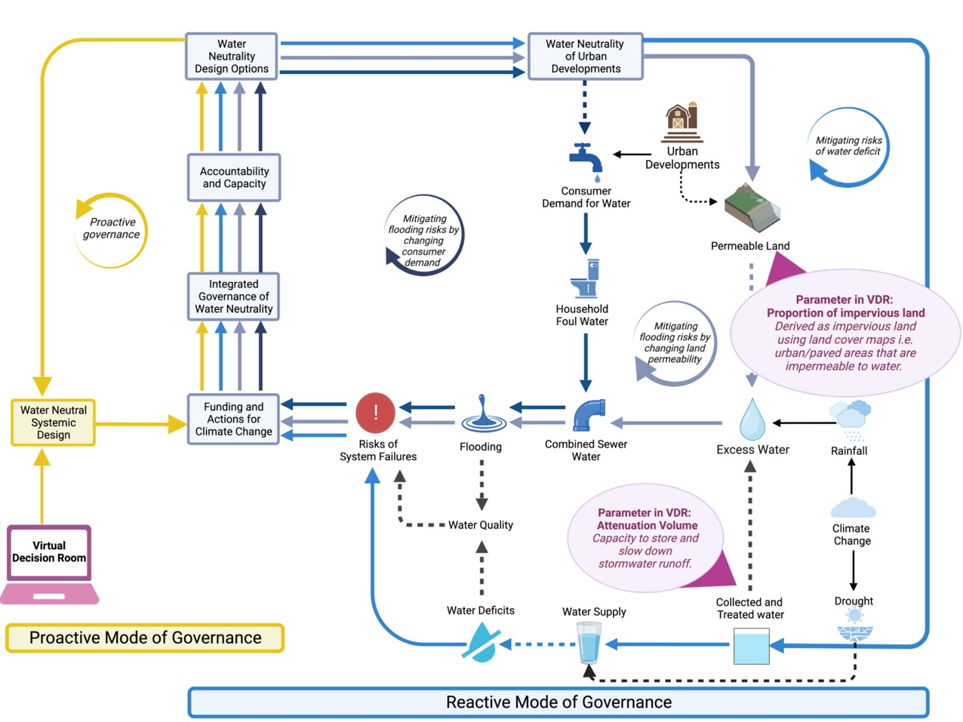
Manchester case study causal loop diagram (3)
Infographics style
VDR model key control variables highlighted in pink bubbles

Slide 8
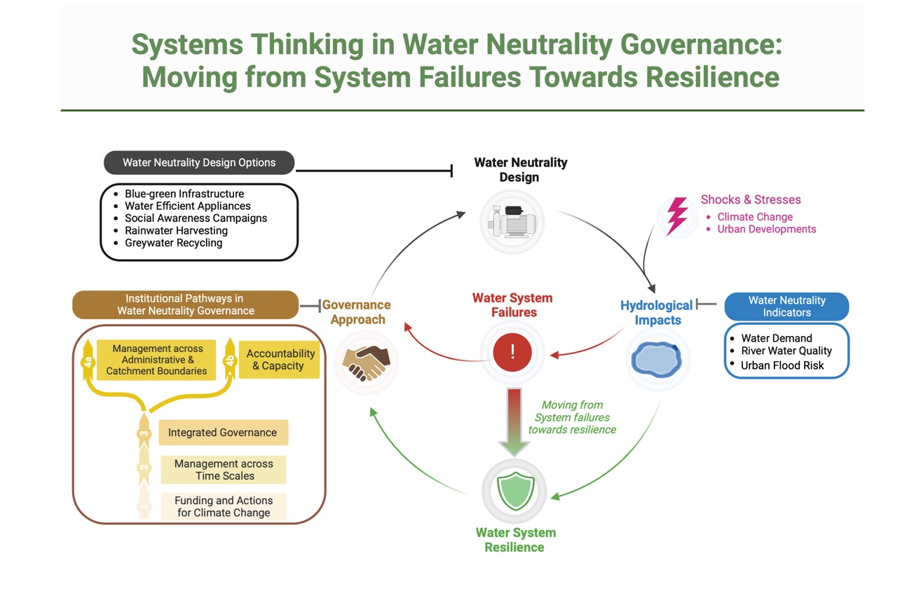
Our key learnings in Manchester case study

Slide 9
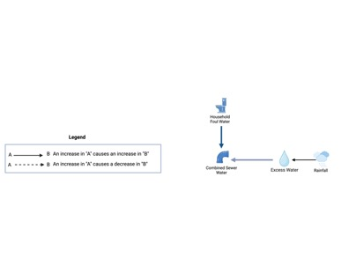
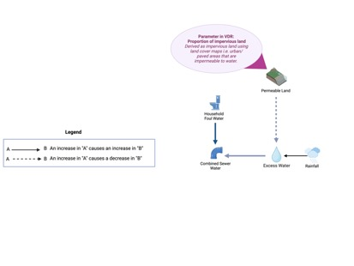
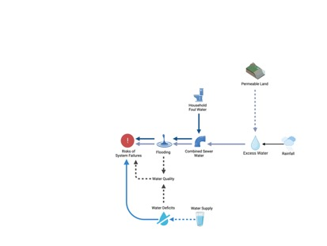
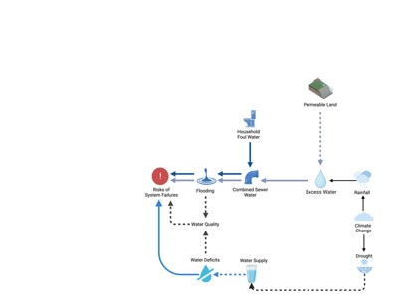
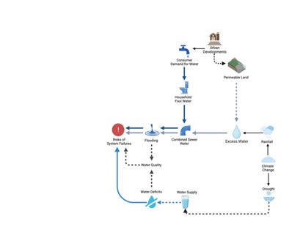
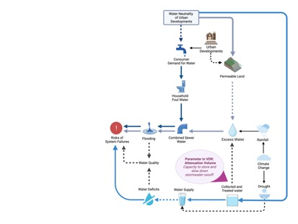

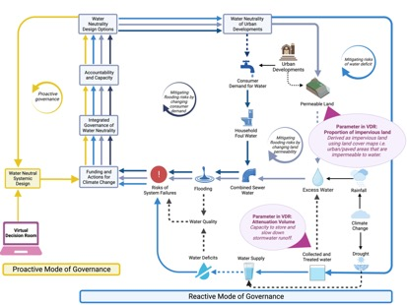
Unfolding the CLD in VDR

Slide 10

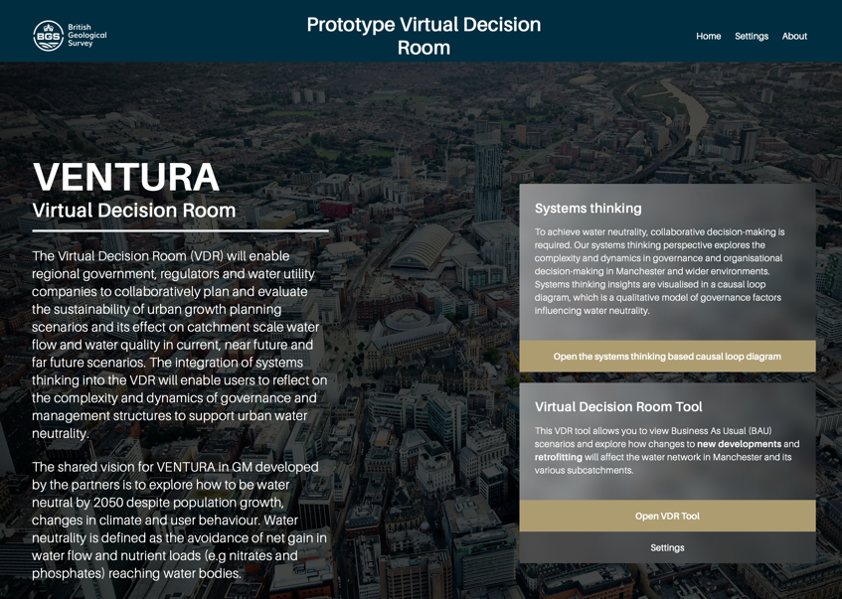
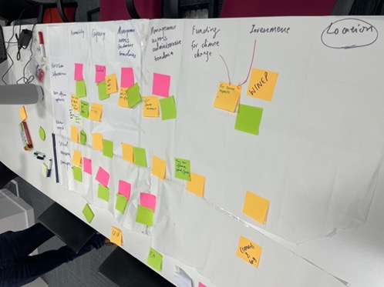
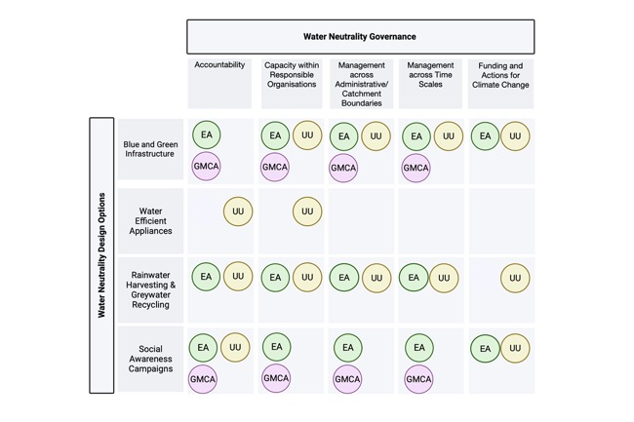
Outputs
Interdisciplinary elements in VDR
User meeting strategic discussions in Manchester

Slide 11
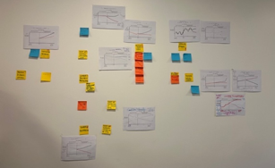
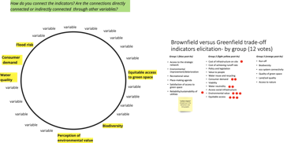
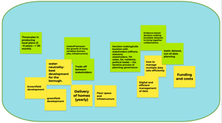
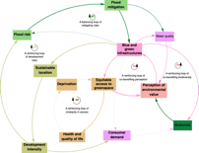
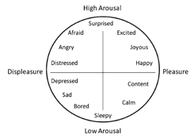
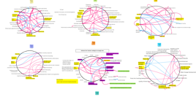
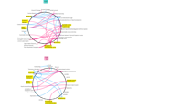
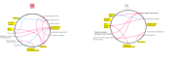
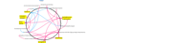
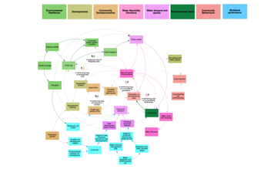
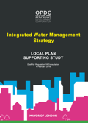
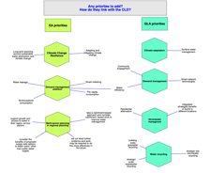
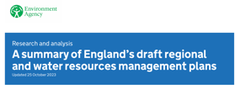
Engagement in Enfield case study
Stakeholders’ input
Research process
Researchers’ input
A. Problem framing
(‘design workshop’)
2
1
4
5
B. Individual interviews
(‘connection circles’)
3
Mapping of systems maps:
The connections between variables by extracting the causal links
Emotions analysis:
The emotions conveyed by the variables when people describe the variables
7
C. Group workshops
(‘group-model-building workshops’)
6
Listing initial organisational priorities

Slide 12
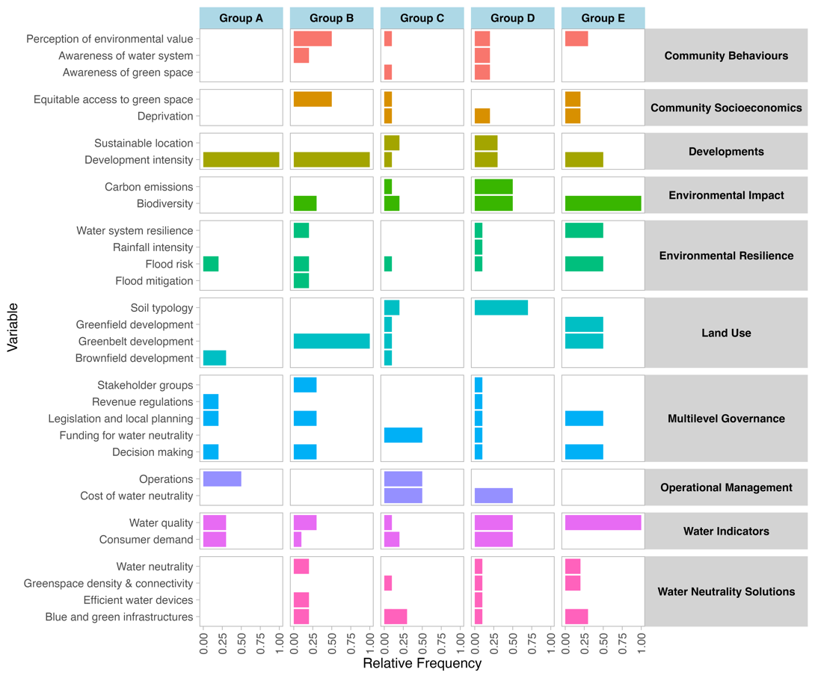

Most commonly variables being mentioned in the interviews, and the initial causal loop diagram (CLD)
The initial CLD
Variables that are perceived with diverse emotions (valence+activation) are less connected in the CLD

Slide 13


Workshop causal loop diagram overview (TW& LBE)
Multilevel governance and operational variables were mentioned in individual interviews; but were less linked to other variables. In workshops, these additions underscore the impact of decision-making from both governance and organizations.
Initial CLD
Group Model Building Workshop CLD from TW&LBE

Slide 14


Workshop causal loop diagram overview (EA & GLA)
Overall, the workshop CLD reflects a comprehensive system where environmental, socio-economic, regulatory, and behavioral factors all interact to shape water neutrality decisions and sustainable development outcomes.
Multilevel governance variables were mentioned in individual interviews; but were less linked to other variables. In workshops, these additions underscore the relationship between water demand, the effectiveness of water management systems, and the broader themes of sustainability within the context of environmental resilience and community socioeconomics.
These additions to environmental resilience (in particularly climate change, rainfall and droughts) suggest a broader, more holistic view of environmental resilience strategies for water neutrality and sustainable development.
Initial CLD
Group Model Building Workshop CLD from EA & GLA

Slide 15






Participatory approaches: engagement, learnings, alignment of priorities
Problem identification & Workshops
Systems maps
Knowledge integration
Effectiveness of a participatory approach: Enhances decision-making through holistic perspectives, promotes collaboration across multiple layers and sectors, and incorporates diverse viewpoints.
Long-term engagement is crucial for the effectiveness of participatory ST approach: Sustained support is crucial for tackling complex issues that span multiple sectors, highlighting the need for ongoing commitment.
Alignment of priorities & understandings: Despite varying priorities among different organizations, focusing on policies, operational management, and common terminologies like 'water neutrality' is essential for holistic approaches.

Slide 16
Thank you for listening
Koko Zhou
UCL Research Fellow
ke.zhou@ucl.ac.uk

Slide 17
Stakeholders’ aims in Enfield case study
Explore water neutrality in decision-making considerations between brownfield and greenfield projects, and examine the broader trade-offs and challenges in development.
Stakeholders aim to introduce digital tools to manage multiple datasets efficiently and reduce the time required to produce local plans.
The goal is to facilitate decision-making when confronted with complexities in water neutrality and urban developments.
Project aims:
Map the complex interconnections between the variables impacting decision-making toward sustainable urban development and water-neutral solutions in several strategic planning areas in the London Borough of Enfield (LBE).
Research Questions:
How do water neutrality indicators such as consumer demand, flood risk, and river water quality link with other variables?
How do various organisational groups perceive the variables in distinct ways?

Slide 18


Emotion boundaries in the CLD

Slide 19


GLA priorities
This map underscores the GLA’s priorities in water neutrality management, highlighting the importance of good growth and adaptation to climate change impacts and sustainable environment.
Climate Adaptation:
This priority focuses on managing stormwater and surface water effectively. This management doesn't necessarily involve the implementation of blue and green infrastructure but includes other strategic measures towards water neutrality.
Flood risk
Good Growth:
This priority refers to the strategic and sustainable approach to urban development. It encompasses delivering housing and commercial growth that considers environmental resources and sustainable growth spatially.
Population growth
Water efficiency
Group Model Building Workshop CLD (EA & GLA) & GLA priorities

Slide 20

EA Priorities
This map underscores the interconnected nature of environmental management, highlighting how regulatory measures, incident response, demand management, and advisory roles work together to create resilient and sustainable communities in the face of climate change and other environmental challenges regarding water.
Environment Regulation:
This is a primary focus for EA and is interconnected with environmental areas.
Biodiversity
Water quality
Consumer demand
Incidents Responsibility:
responding to environmental incidents regarding resilience aspects in the CLD.
Droughts
Flood risks
Flood mitigation
Extreme rainfall
Multisector Planning:
EA serves as a statutory consultee, providing expert advice on environmental matters when planning decisions are made, and growth access to water, with catchment based approach in water management.
Water legislation and environmental act
Water quality
Demand Management Ambition:
Considerations in smart metering.
Water efficiency
Group Model Building Workshop CLD (EA & GLA) & EA priorities

Slide 21

Overview of EA&GLA Priorities
Overlapping and interconnecting areas
Catchment-Based Approach:
Managing water resources and development within the natural boundaries of a river catchment area.
GLA: This strategy sits at the intersection of climate adaptation and good growth for GLA.
EA: It also is part of EA’s priority on multi-sector planning in regional planning.
GLA priority
Water resources planning & Environment planning consultee:
Part of GLA’s climate adaptation, which links with EA’s environment regulation
EA
priority
Group Model Building Workshop CLD (EA & GLA) & GLA priorities

